Slide 1



Pizza Report
View in Power BI
Last data refresh:
5/6/2024 11:15:50 PM UTC
Downloaded at:
5/6/2024 11:17:25 PM UTC

Slide 2
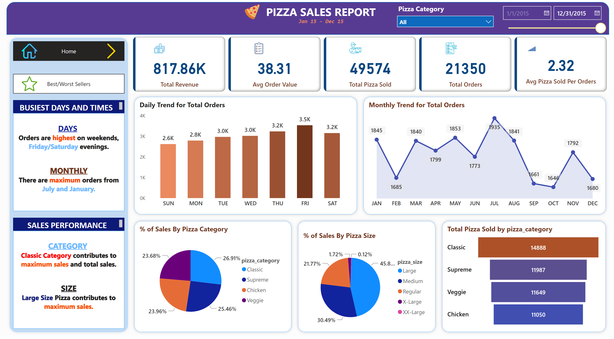
Home
Notes:
cardVisual
No alt text provided
shape
No alt text provided
textbox
No alt text provided
textbox
No alt text provided
image
No alt text provided
shape
No alt text provided
Daily Trend for Total Orders
No alt text provided
shape
No alt text provided
Monthly Trend for Total Orders
No alt text provided
shape
No alt text provided
shape
No alt text provided
shape
No alt text provided
% of Sales By Pizza Category
No alt text provided
% of Sales By Pizza Size
No alt text provided
funnel
No alt text provided
shape
No alt text provided
textbox
No alt text provided
textbox
No alt text provided
textbox
No alt text provided
textbox
No alt text provided
slicer
No alt text provided
slicer
No alt text provided
pageNavigator
No alt text provided
pageNavigator
No alt text provided
image
No alt text provided
image
No alt text provided
image
No alt text provided

Slide 3
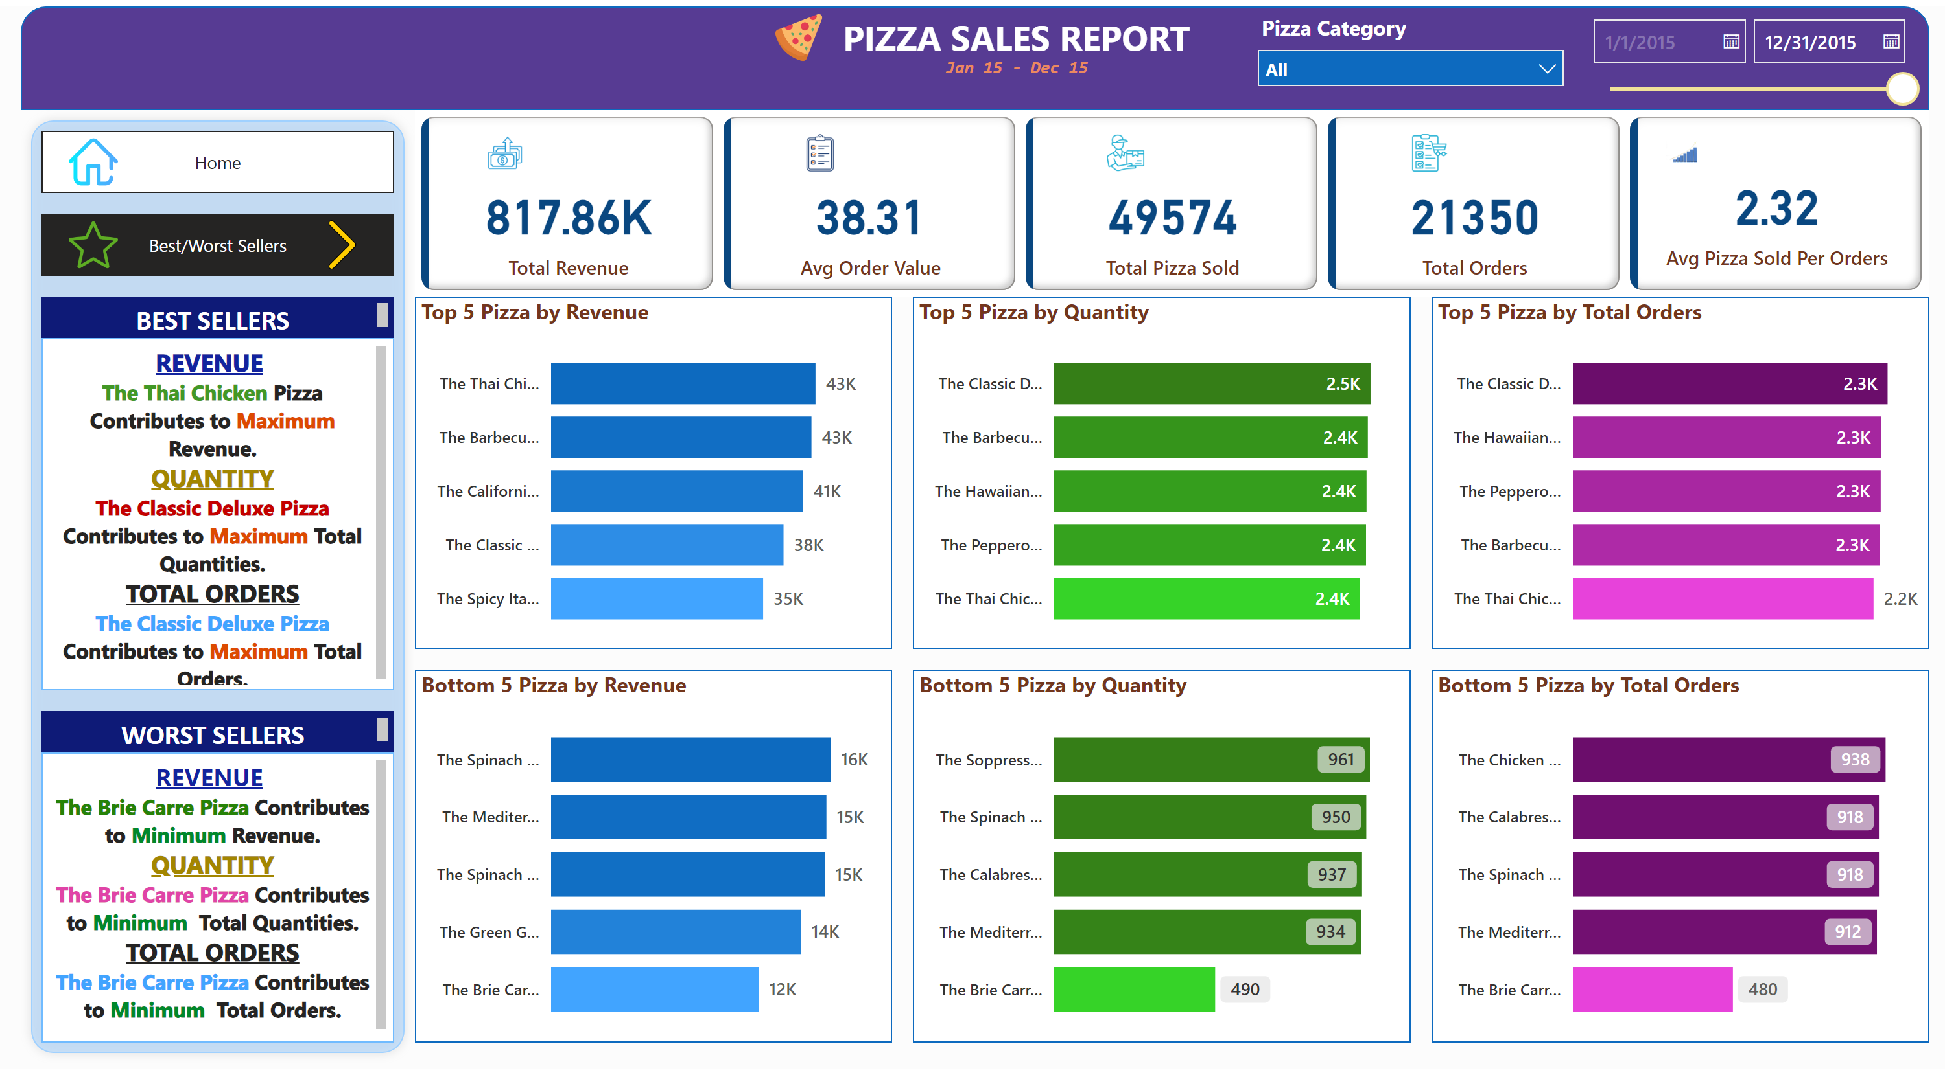
Best/Worst Sellers
Notes:
cardVisual
No alt text provided
shape
No alt text provided
textbox
No alt text provided
textbox
No alt text provided
image
No alt text provided
shape
No alt text provided
textbox
No alt text provided
textbox
No alt text provided
textbox
No alt text provided
textbox
No alt text provided
slicer
No alt text provided
slicer
No alt text provided
shape
No alt text provided
shape
No alt text provided
shape
No alt text provided
shape
No alt text provided
shape
No alt text provided
shape
No alt text provided
Top 5 Pizza by Revenue
No alt text provided
Bottom 5 Pizza by Revenue
No alt text provided
Top 5 Pizza by Quantity
No alt text provided
Bottom 5 Pizza by Quantity
No alt text provided
Top 5 Pizza by Total Orders
No alt text provided
Bottom 5 Pizza by Total Orders
No alt text provided
pageNavigator
No alt text provided
pageNavigator
No alt text provided
image
No alt text provided
image
No alt text provided
image
No alt text provided

